Slide 1
Shopping Website (Best Buy)
Group 6 Dhankuwar Sisodiya, Ravi Pilla, Neel Shah, Tian Wang, Xin Tang, Yafu Zhang

Slide 2
Index
Skeleton Plane
Surface Plane
Information Architecture
Google Material Design
Use Cases
Personas
Testing Methodologies

Slide 3
Skeleton Plane
Skeleton is the concrete expression of the more abstract structure of the site
Here we start designing interface elements that will facilitate the user’s understanding and movement through the product
The Skeleton is designed to optimize the arrangement of UI elements for efficiency and ease of use

Slide 4
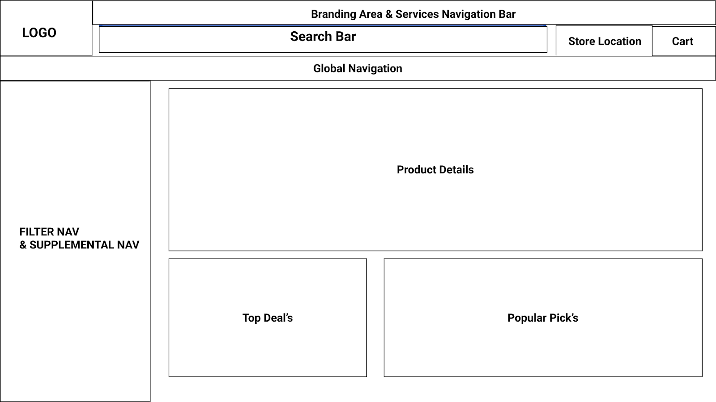
Design Options | Designers / Stakeholders
Skeleton
Interface Design | Checkboxes used for filters such as availability, brand names, etc. Text boxes to take price input on filters and search boxes Drop down for sort by options Maps included for choosing store location

Slide 5
Navigation map | Global Navigation Products Appliances TV & Home Theater Computer & Tablets Cell Phones Audio Video Games Brands 1. Best Buy Brands 2. Apple 3. Samsung 4. Lenovo 5. HP 6. Microsoft 7. Sony 8. Intel

Slide 6
Navigation map (Contd..) | Deals Top Deals Deal of the day Member Offers Clearance Services Visit Service Center Schedule a service Manage an appointment Shop with an expert Account Info Recently viewed Order Status Saved Items

Slide 7
Navigation map (Contd..) | Branding Area Service Navigation Bar 1. Customer Support 2. Credit Card 3. Top Deals 4. Deal of the Day 5. Gifts 6. Health & Wellness 7. Business 8. Language Options

Slide 8
Surface Plane
Surface is the ‘skin’ layer of the product.
Here, designers dive into the visual treatment of the product to create the packaging, the final ‘look-and-feel’, of the product.
This is where the content meets users’ senses

Slide 9
Design Options | Designers / Stakeholders
Color Scheme | Primary Color - #1549B4 Secondary Color - # FEEF50
Typography | Font Family - Roboto Headings color - #000000 or #1549B4 Body color and font - #000000, Roboto
Forms | Forms should be centered Headings: Bold, #000000, 32px Text fields: 10px border radius Checkboxes for account recovery options, remember me, terms and conditions Primary buttons - #1549B4 with #ffffff text Secondary buttons- #ffffff with #1549B4 text

Slide 10
Information Architecture
IA is a blueprint of the design structure which can be generated into wireframes and sitemaps of the project.
Techniques used in Case study for Best Buy -
Conduct a heuristic evaluation
Conduct one round of open card sort
Conduct one round of closed card sort
Create a sitemap

Slide 11
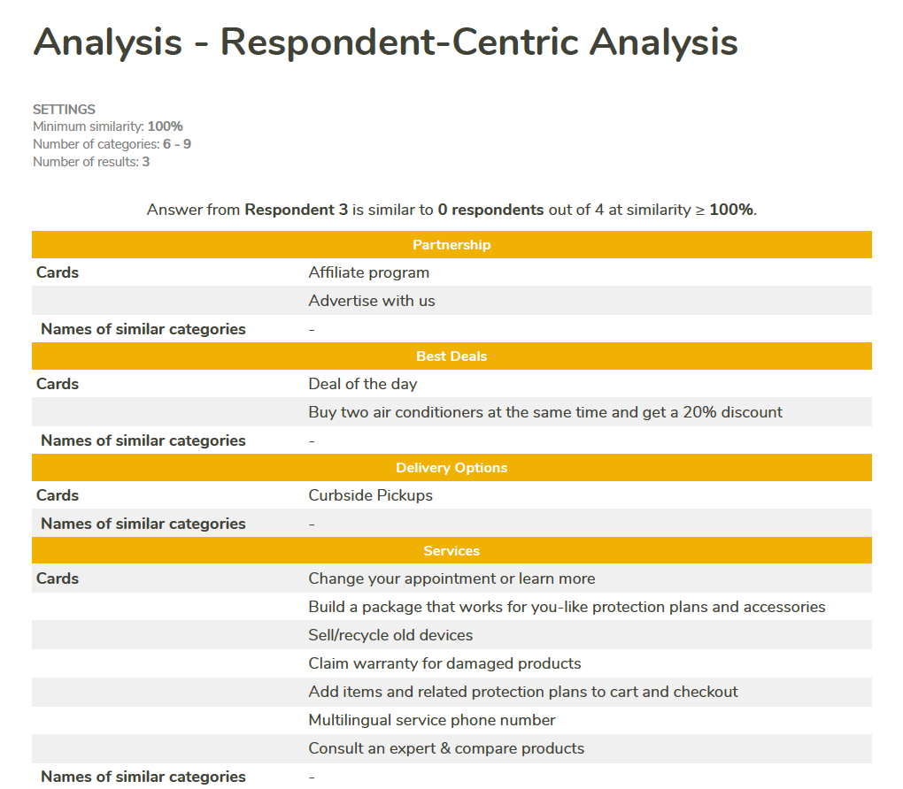
Open Card sort -
Open Card Sorting is where the participants are asked to organize topics from content within the website into groups that make sense to them and then name each group they created in a way that they feel accurately describes the content.
UX tweak for open card sorting -
Open -

Slide 12
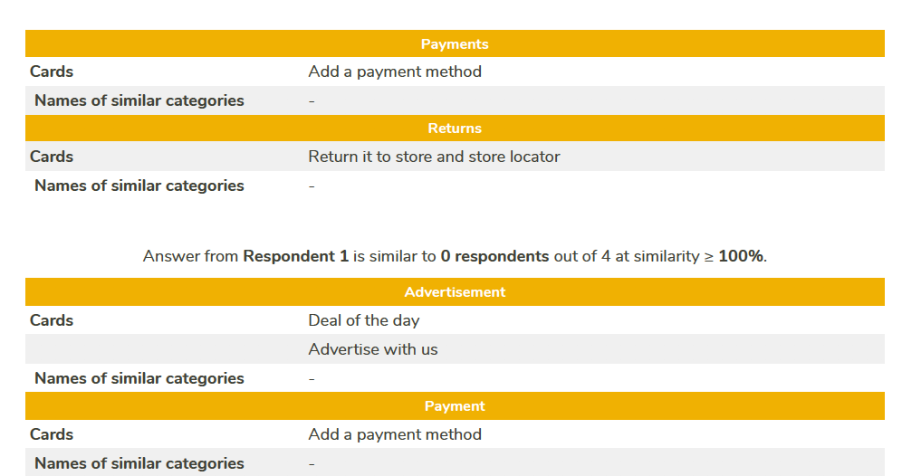
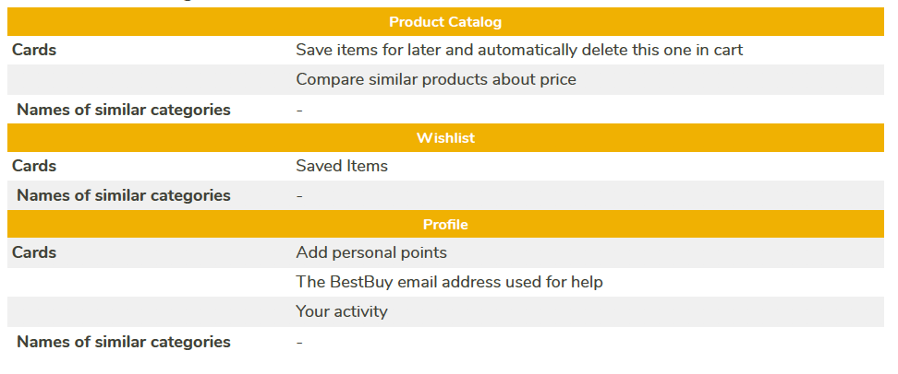

Slide 13
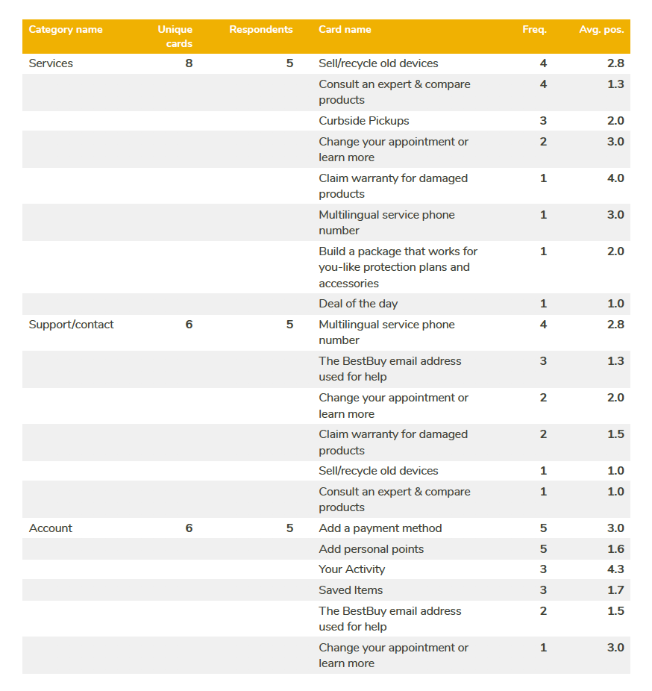
Closed card sorting is a variation where users are given a predetermined set of category names, and they are asked to organize the individual cards into these predetermined categories.
UX tweak for closed card sorting -

Slide 14
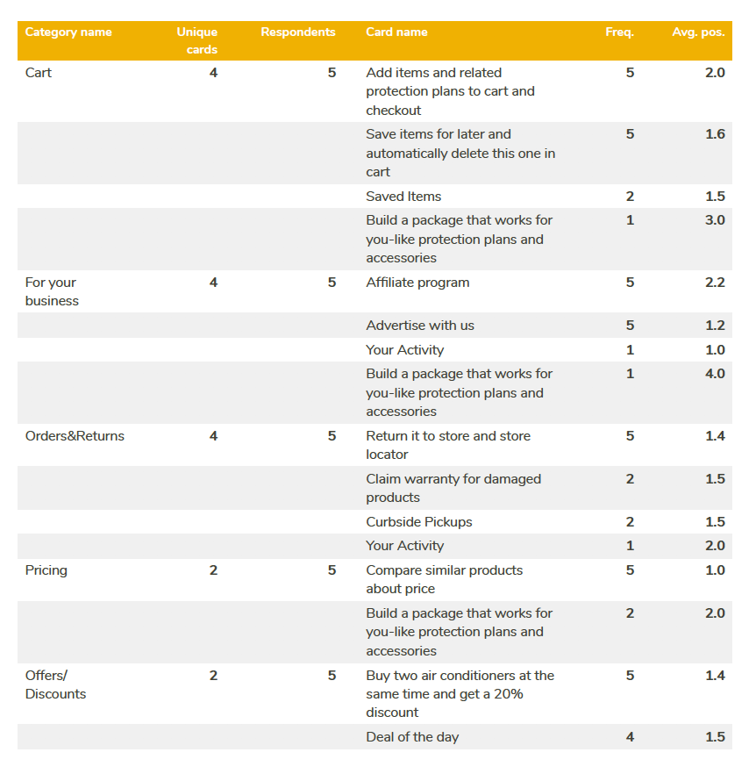

Slide 15
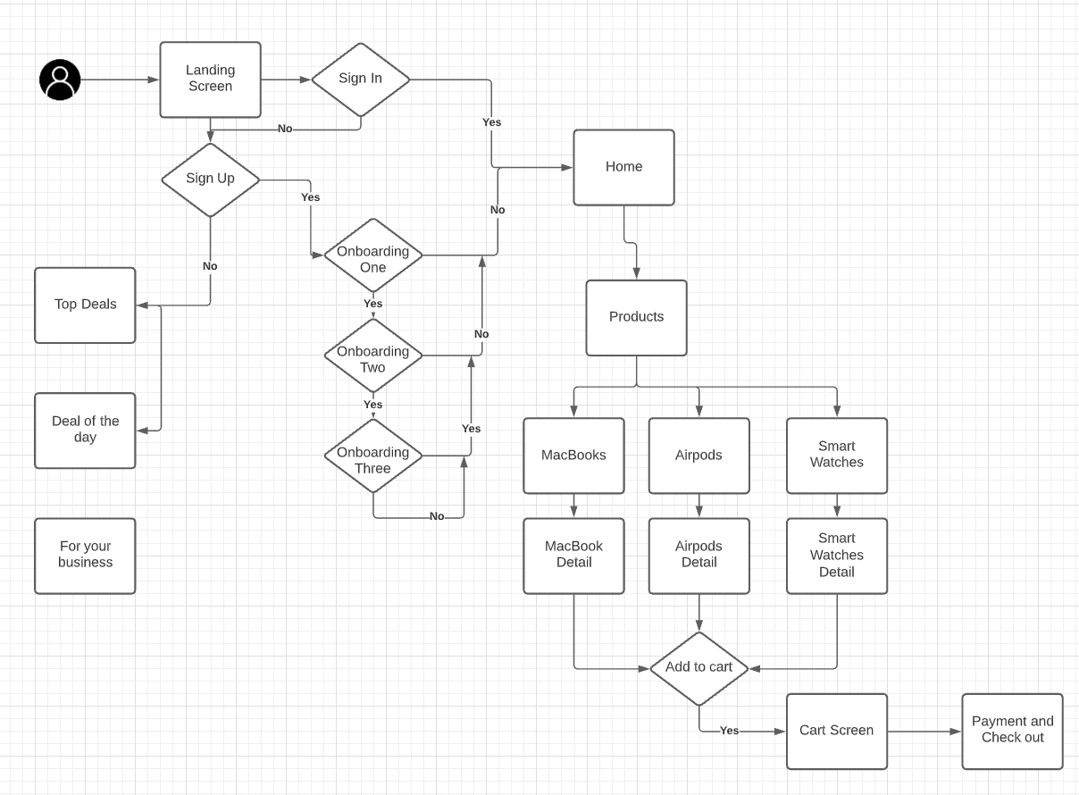
A UX sitemap is a hierarchical diagram of a website or application, that shows how pages are prioritized, linked, and labeled. If a user flow is like the street view details, the sitemap is like the bird’s eye view.

Slide 16
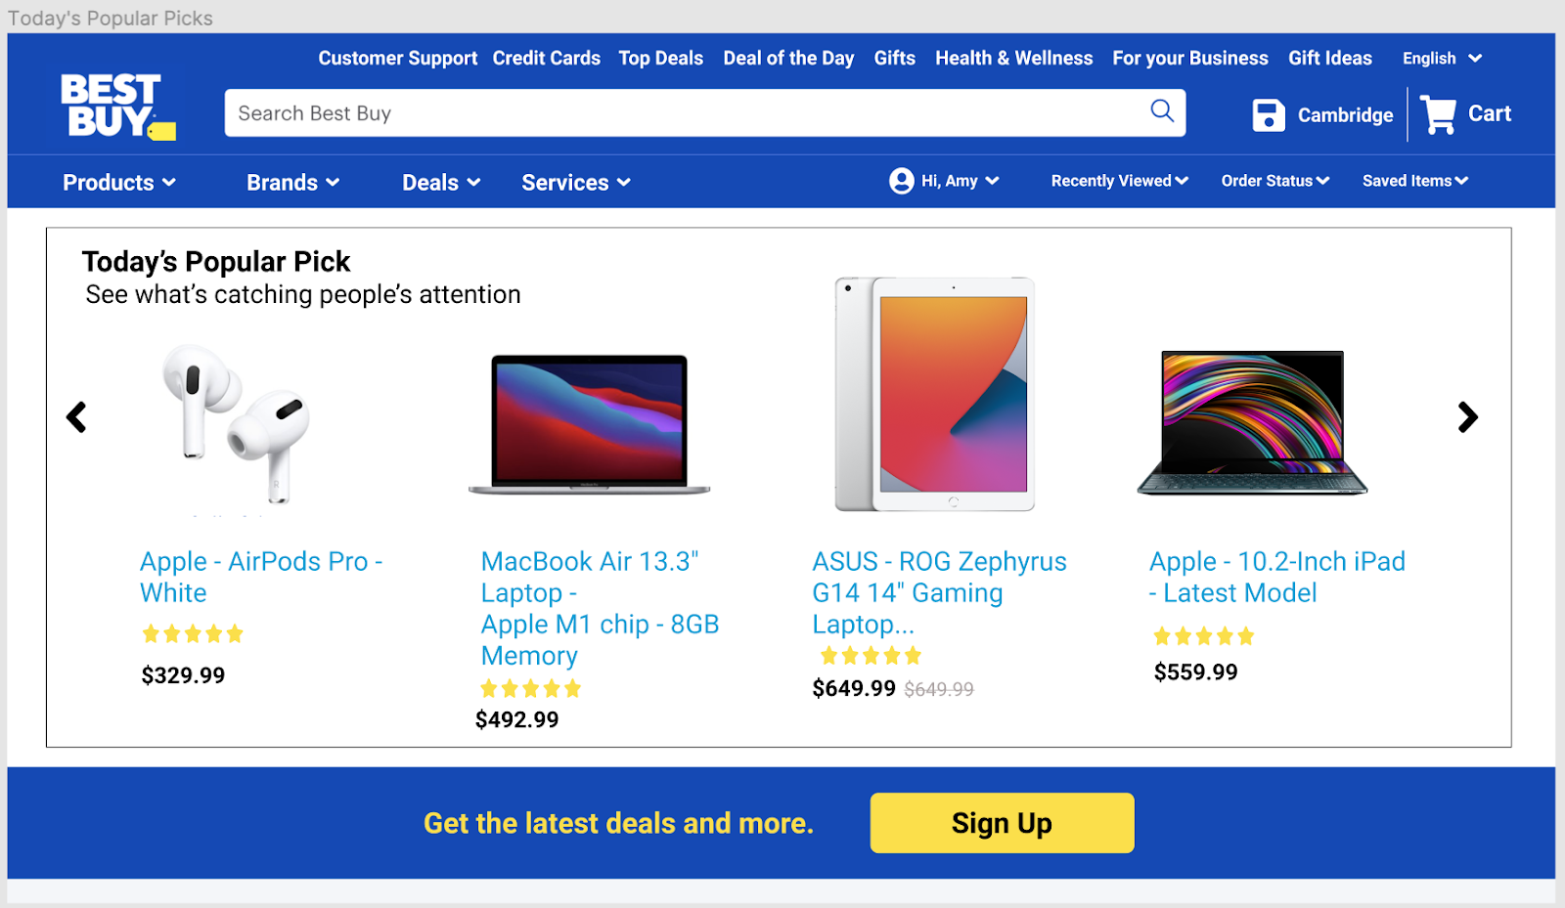
Google Material Design
Material is the metaphor
Best Buy is a multinational consumer electronics retailer. Its main business is inseparable from technology products. Blue can be reminiscent of the latest technology, and a small amount of yellow can stimulate users’ desire to buy. because they make it easier for users to imagine and feel more natural.

Slide 17
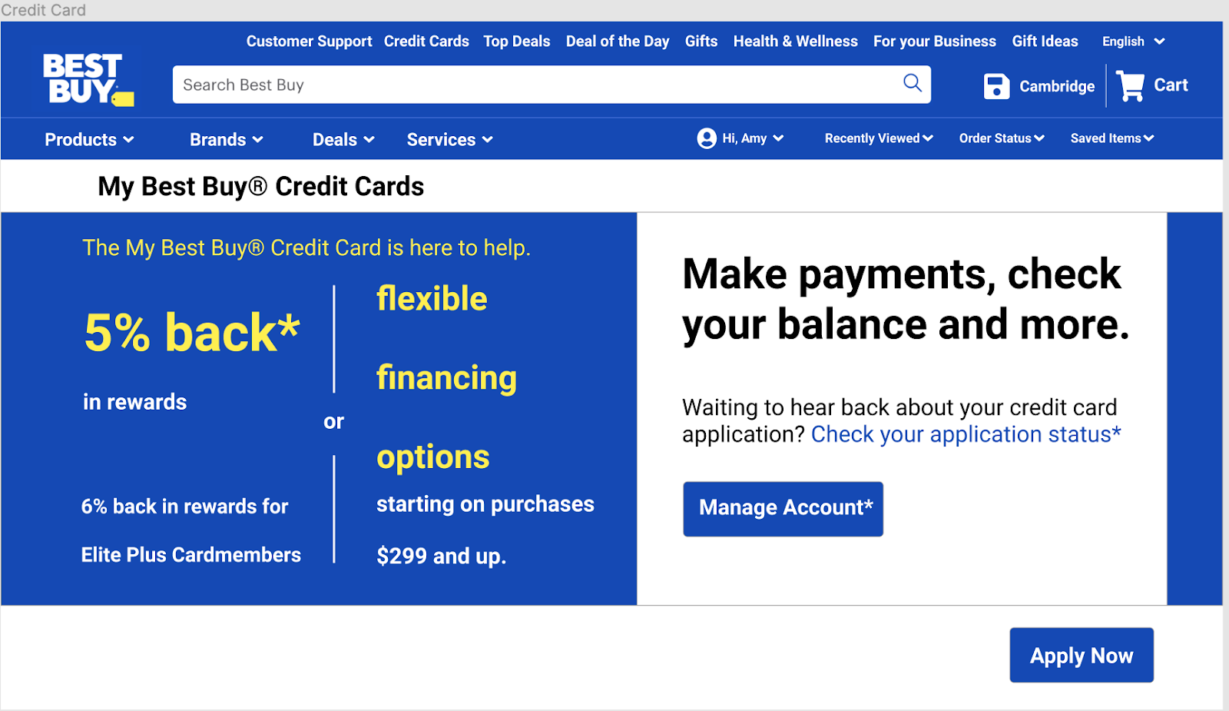
Bold, graphic, intentional
Bold font allows users to grab the most intuitive information the first time, and can also leave a deep impression, such as the percentage of credit card rebates. Nothing is more exciting than discounts or rebates in digital information.

Slide 18
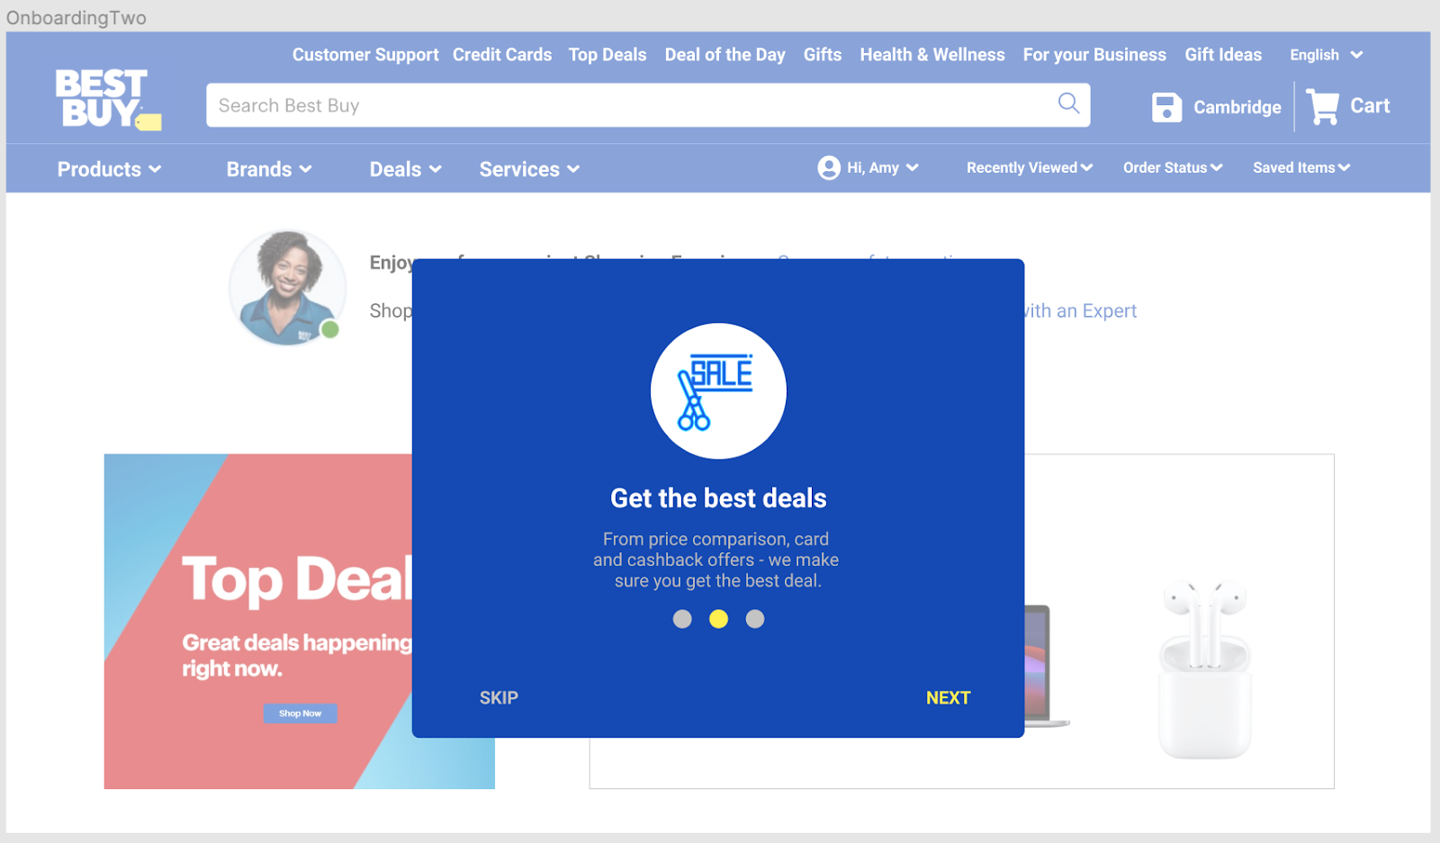
Bold, graphic, intentional
Such a rotating card attracts the user's attention and allows the user to focus on the content of the card. On the panel where the card is located, even switching between cards will not break the continuity of the user's reading, on the contrary, the control of parts or categories is clearer.

Slide 19
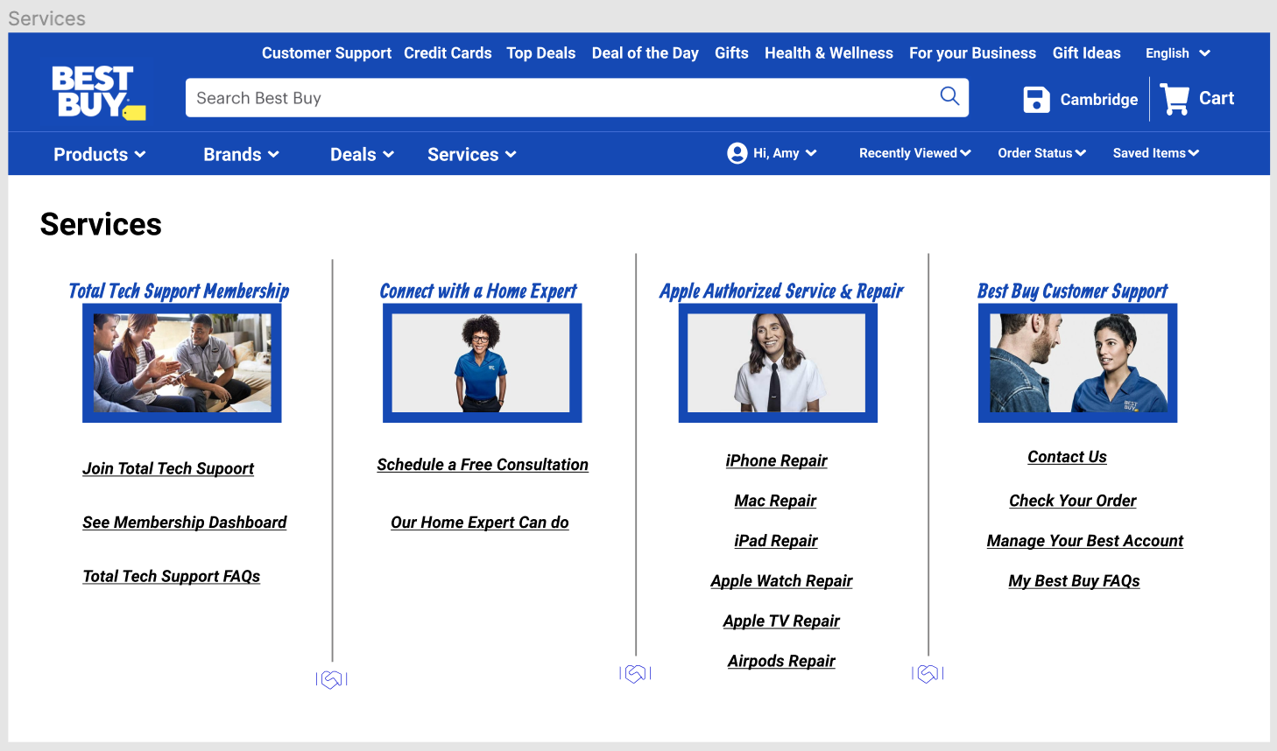
Environment
In the service interface, it is divided into four categories, and the different promotional images in each category are decorated with fixed shadows. Such an environment can be clearly classified at a glance, and does not stick to the traditional environment layout.

Slide 20
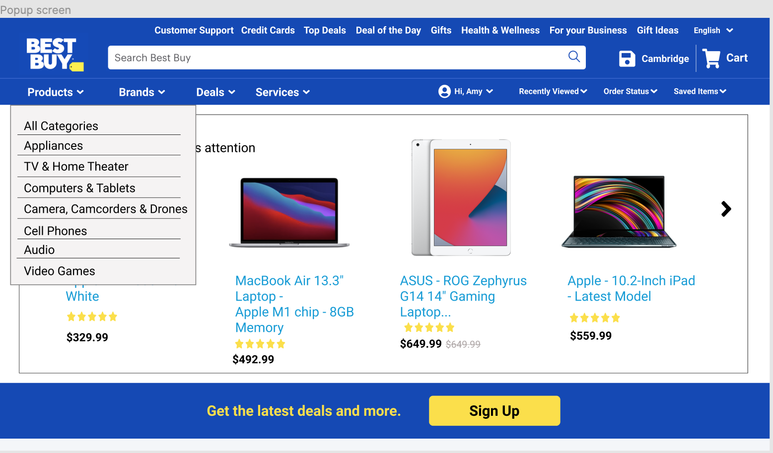
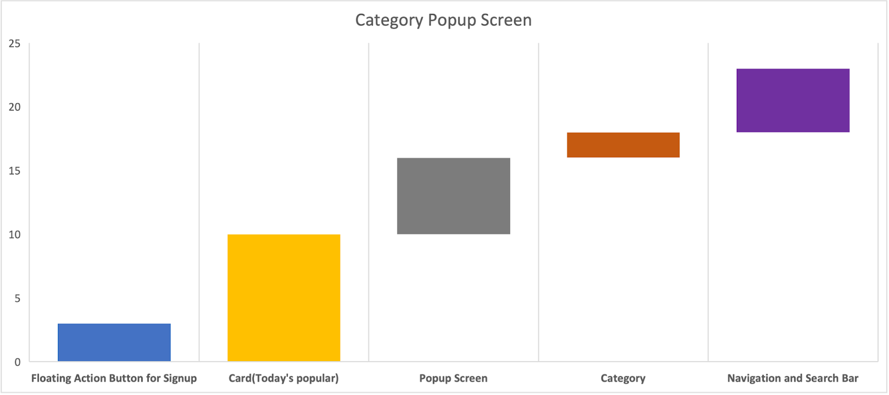
Elevation
The popup screen page of Best Buy layout with an open navigation drawer and floating action button for signup at the bottom, along with a cross-section diagram of its component elevations along its z-axis.

Slide 21
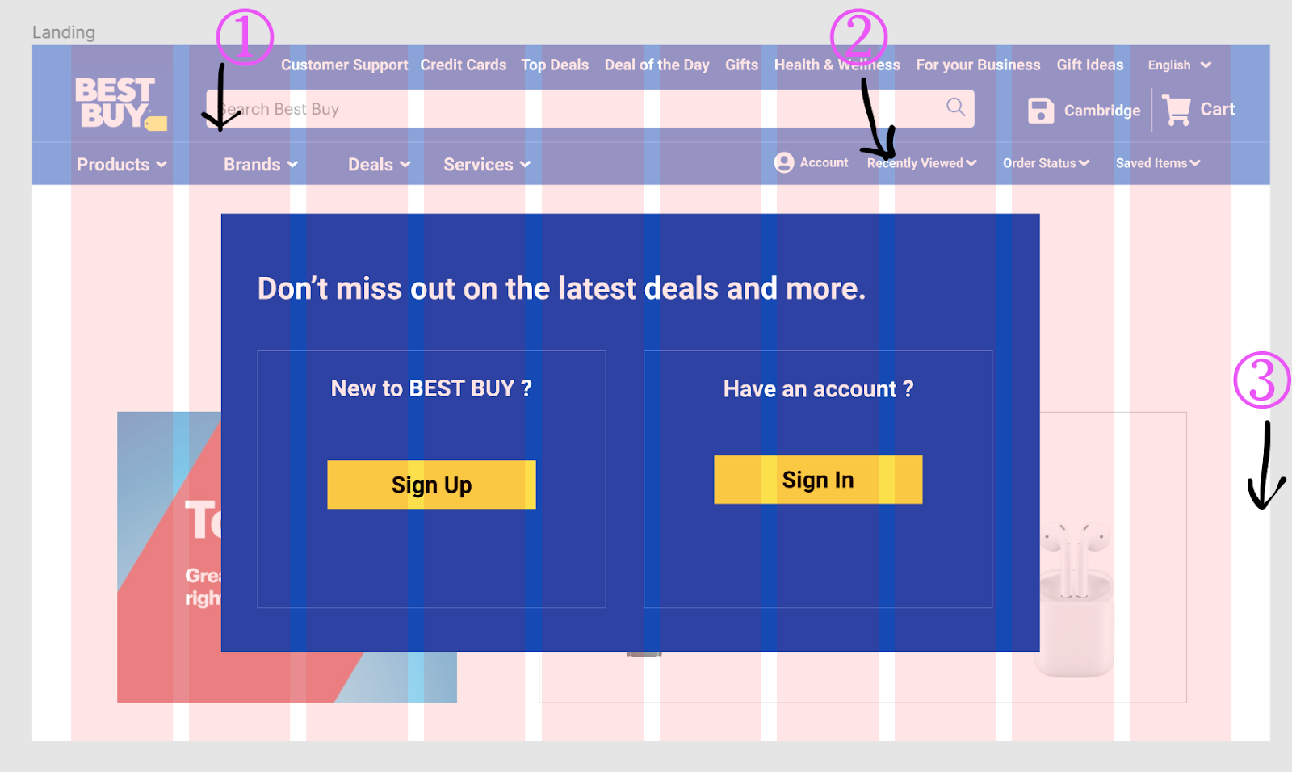
Responsive Layout grid
The Material Design responsive layout grid is an comprehensive guide to the placement of components and elements. The responsive layout grid adapts to screen sizes and orientation, ensuring consistency across layouts.
① Columns ② Gutters ③ Margins

Slide 22
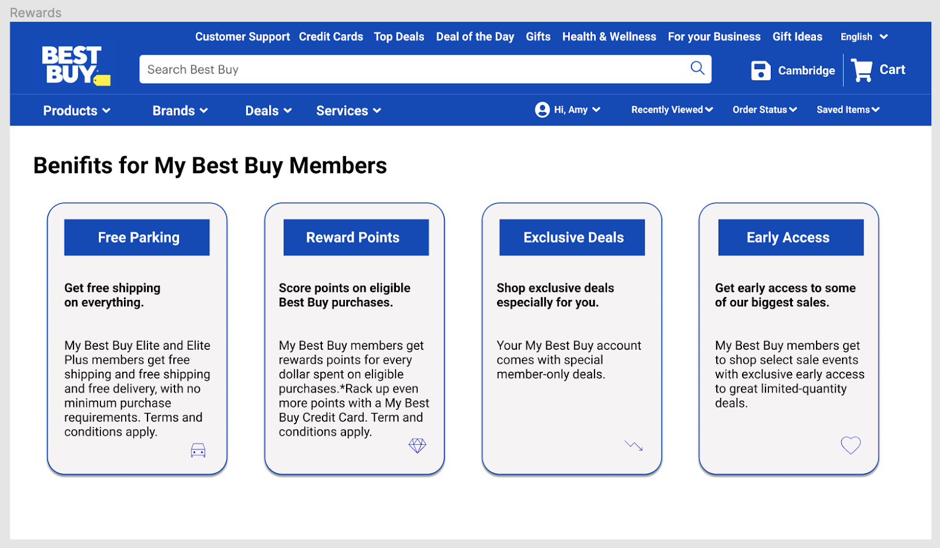
Actions with rounded edges can provide a compelling user experience.
Iconography: Material icons use geometric shapes to visually represent topics.

Slide 23
Use case 1 | Teenager with pre-existing clarity on what product to buy
User: | Teenager
Pre-Condition: | User has to have an internet connection User has a basic knowledge of web browsing User must be able to do online payments if necessary
Basic Flow: | User opens the website and searches for the product he intended and browses through list of results and buys the desired product by making payment online and opting for delivery option
Alternate flow: | User may visit the nearest store experience the product physically and then check for offers online and buy as a pickup at store
Termination Outcome: | User has successfully found the product he is looking for and placed an order

Slide 24
Use case 2 | Teenager who visit the website casually and buys a random product
User: | Teenager
Pre-Condition: | User has to have an internet connection User has a basic knowledge of web browsing User must be able to do online payments if necessary
Basic Flow: | User may casually look at different set of products using the dropdowns on the top and buy if anything looks interesting. User may end up buying a product which he/she is not intended to buy.
Alternate flow: | User may visit the nearest store and have a look at different products physically and then check for offers online and buy as a pickup at store
Termination Outcome: | User might not find anything interesting and does not place an order

Slide 25
Use case 3 | Person who does not know English
User: | Teenager
Pre-Condition: | User must be having a working internet connection User must be accompanied by a person who can assist
Basic Flow: | User Browses through products by looking at pictures & be able to navigate to different sections with the help of his friend in understanding product description
Alternate flow: | User Browses through the products but could not understand product description completely in spite of his/her friend helping him/her. User leaves the website and purchases the product by visiting a nearby store User may place an order for a pickup at the store instead of making payment online
Termination Outcome: | User may find it difficult with translations, navigation & may visit any other website for same with supports internationalization

Slide 26
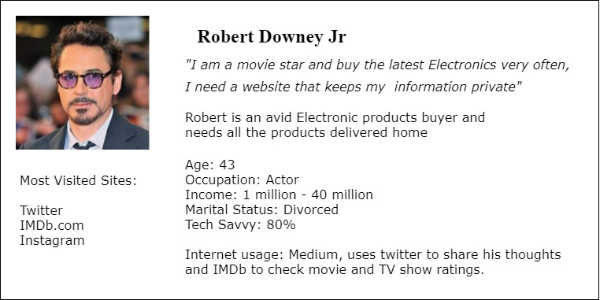
Personas

Slide 27
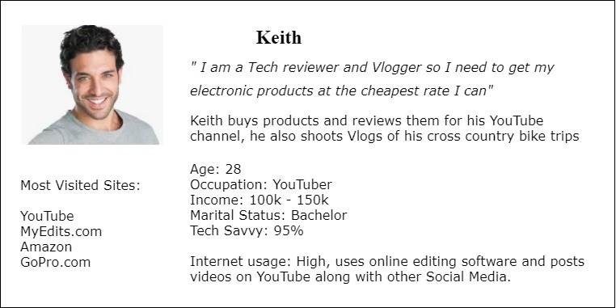

Slide 28
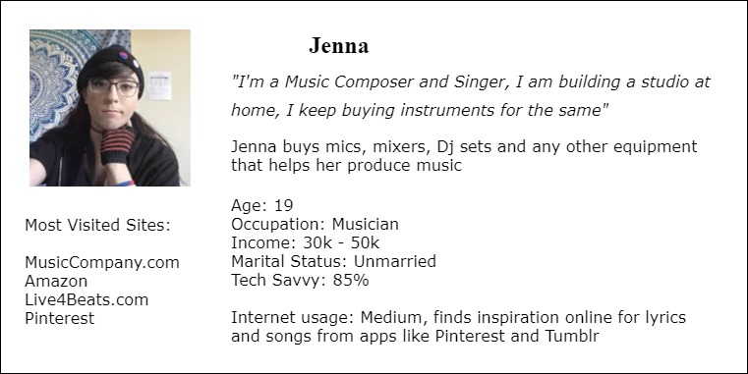

Slide 29
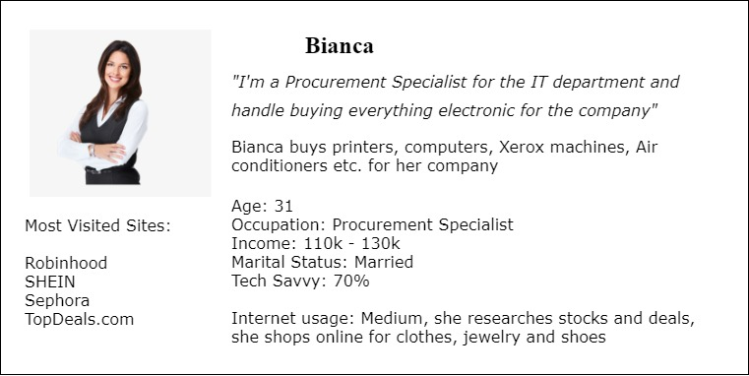

Slide 30
Testing Methodologies
Testing
Usability Testing
● Test plan
● Expectation & Feedback
Test Objectives
● To test the ease of use and overall flow of the prototype
● To test whether users are able to complete the tasks given to them
● To gain insight into the frustration and pain points of the user
Tasks
● Search for a product category
● Search for a product via the search bar after successful sign in
● Add products to the cart
● Add payment options
● Make a payment and track order

Slide 31
Usability Test Findings
Insights:
● User was able to signin/signup without any issue
● Most of the users preferred search bar compared to the drop down categories in finding their desired product
● Most of the users used filtering options inside a product category to find the suitable configuration
● Users could not find the customer support option easily on the Landing Screen
● Non native english users found it difficult to understand few categories

Slide 32
Recommendations
Customer Support option must be included on the top of the navigation panel
Support for internationalization must also be included in the header section
Use forms to help users compare similar products
Removed product details from Today’s popular picks section for minimalism and to avoid bombarding the customer with too much information
Added Sign up/ Sign In with Apple ID feature for flexibility
Added a phone Number option for password resetting for more options
Added tracking orders functionality for product delivery transparency
Giving users options in chat box to contact and ask questions or read answers from Q&A database, with functions such as email or live chat.

Slide 33
DEMO

Slide 34
Thank you
Group 6 Dhankuwar Sisodiya, Ravi Pilla, Neel Shah, Tian Wang, Xin Tang, Yafu Zhang

